Slide 1
Harness the power of Elastic Observability and AI to solve complex problems at scale
Presenter name: Subtitle, Inter, normal, 18pt
Mon 00, 0000

Slide 2
Agenda
1
Intro
2
Pain Points and Architecture
3
AI-Powered Observability
4
Q&A

Slide 3
BPCE IT - BIO

Slide 4
Over the last decade,
the business demands of IT have outpaced human reach

Slide 5




So we built systems to scale
➤
Kubernetes
Infrastructure Scale
Cloud
Distributed Services
Time

Slide 6
Now your applications are complex
Elasticsearch
Newsletter
Ad service
Cart
Redis
Currency
Browser
Frontend
Checkout
Email
Recommend
Payment
Postgres
Shipping

Slide 7



And you can’t get the answers you need
What is my system doing?
How do I fix it?
Who is impacted?
Is it working or not?
SRE/DevOps
Dev
CIO

Slide 8
BPCE IT

Slide 9

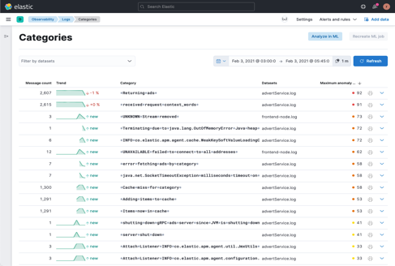
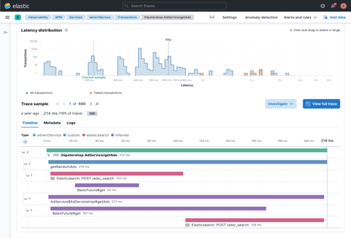
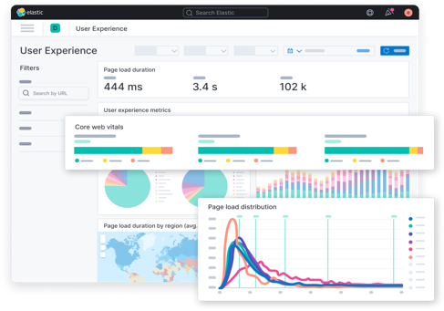
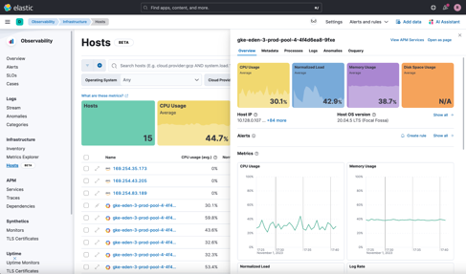
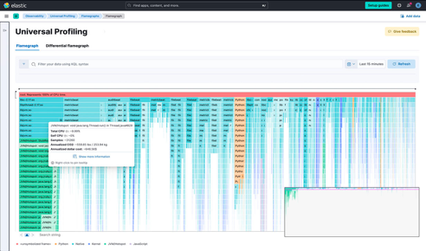
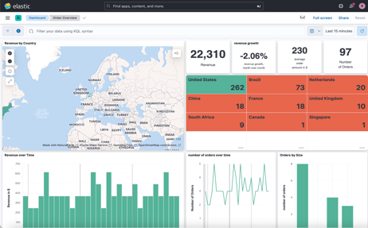
You need signals to get answers
Logging
Tracing
RUM
Infra metrics
Profiling
KPI metrics

Slide 10









And an intelligent, scalable analytics platform
Ingest
Analytics
Action
Correlation
Alerting
Autonomous AI Agent
Logs
Incident response
Operational Data
Metrics
LLM Integrations
Time series and events data
Insights
Traces
Cost optimization
Profiling
Runbooks
Business Data
Custom KPIs
Security
SLI/SLOs
ML and AI
Unified Datastore
Feedback loop - recall / knowledge base
Notes:
Let's dive into the Anatomy of an AIOps Solution, a transformative approach that leverages Machine Learning and AI to enhance IT operations. This diagram illustrates the key components and processes that make up a comprehensive AIOps framework.
Visibility
We begin with Visibility. AIOps provides a panoramic view of our IT landscape, aggregating data from multiple sources such as Azure, Google Cloud, AWS, and more. It captures and integrates diverse data types, including logs, metrics, traces, and business KPIs. This holistic view is crucial for understanding the full context of our operational data and the performance metrics that drive business outcomes."
Correlation and ML/AI
At the core, we have Correlation powered by Machine Learning and AI. AIOps platforms process the time-series and event data, correlating information to identify patterns and anomalies. By leveraging ML and AI, the system can learn from data, predict issues, and provide actionable insights. This not only simplifies the complexity of data but also enhances our ability to make informed decisions quickly."
Insight and Unified Datastore
Insight is what we strive for. With a Unified Datastore, AIOps consolidates data into a single source of truth, facilitating advanced analysis. This integration allows for a feedback loop, where the system continuously learns and improves, enriching the knowledge base over time. It enables root cause analysis (RCA) by tracing issues to their source, streamlining the troubleshooting process."
Action
Moving on to Action. This is where AIOps becomes proactive, employing Autonomous AI Agents for real-time responses, integrating with low-level mechanisms for instant incident response, and optimizing costs. Runbooks are suggested, security is reinforced, and the overall system's resilience is elevated. These actions are driven by the insights gained, ensuring that the operations are not just reactive but preemptive."
Alerting and RCA
And finally, Alerting and RCA—Root Cause Analysis. AIOps doesn't just notify us about issues; it helps us understand why they happened. This enables us to address the root of the problem, not just the symptoms, fostering a more stable and robust IT environment."
Closing
In essence, the AIOps solution is like the central nervous system of IT operations, integrating visibility, insight, and action seamlessly. It ensures that we're not just collecting data but transforming it into a strategic advantage. With this anatomy of AIOps, we can anticipate and resolve issues before they impact the business, ensuring a future where IT operations are predictive, not just preventative.

Slide 11



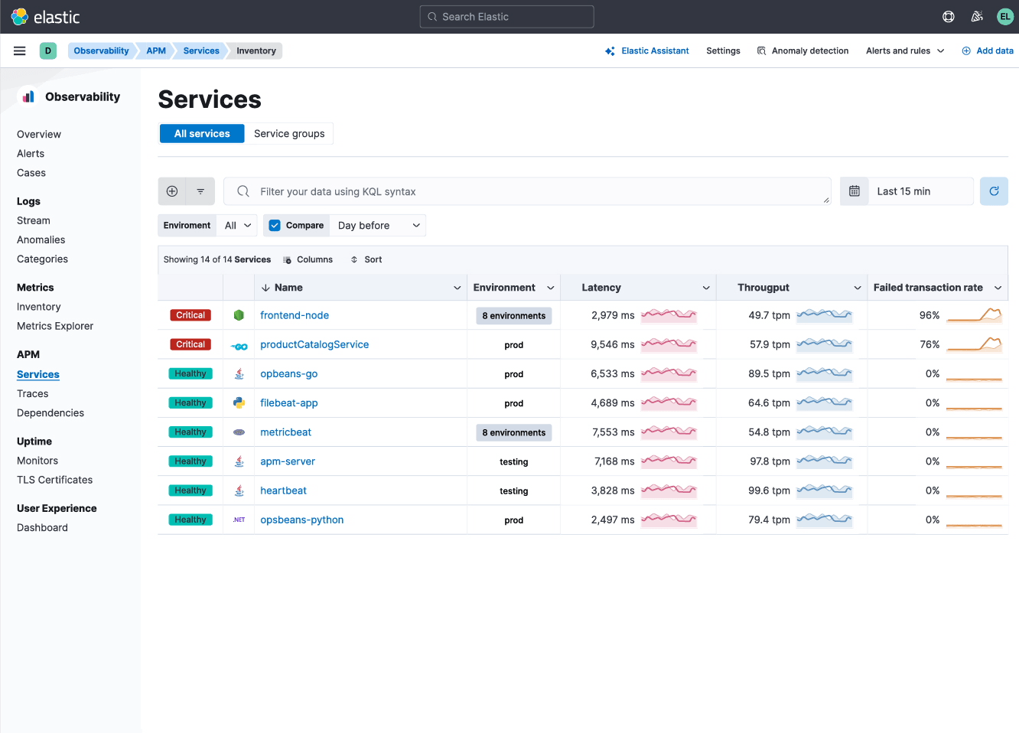
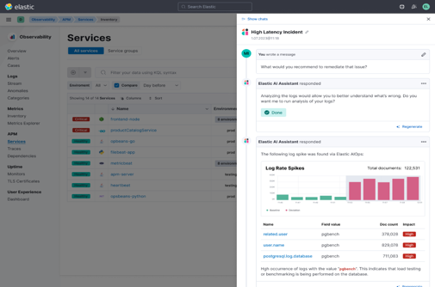


AI Assistant based business and operational analysis
Improved insights and collaboration
SRE
Events
Operational Data
Logs
Metrics
DevOps
Traces
Profiling
Animating this would be awesome
Security
Business Data
Custom KPIs
SLI/SLOs
Is my infrastructure optimized?
Are transactions decreasing?
Are my SLOs being meet?
What is the application's throughput, latency, etc.?
Are cloud costs increasing?
Are dev pipelines optimized?
Dev
Ingest and analyze every signal/data with AI and search
CxO
Powered by
Notes:
Elastic AI assistant for Observability accelerates incident management and root cause analysis
by breaking down knowledge silos and enabling teams
to interactively explore problems and execute remedies with generative AI
Powered by the Elasticsearch Relevance Engine nd OpenAI
it generates trustworthy context-aware, business-specific output
based on your proprietary data, such as knowledge bases and runbooks — Accelerate incident management and root cause analysis
Interactively explore problems and execute remedies with generative AI
Context-aware, business-specific output you can trust
Based on your proprietary data and runbooks

Slide 12

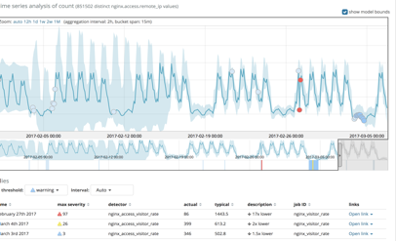
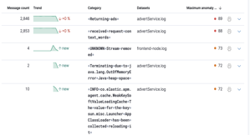
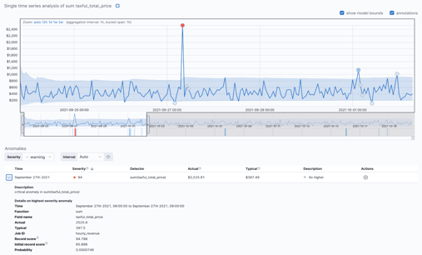
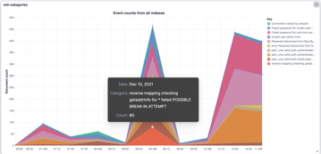
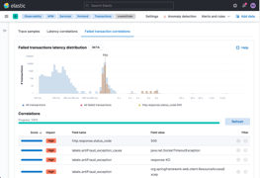
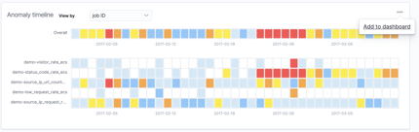



Advanced ML and AIOps Reduces MTTX and finds the impact
Unique, Out-of-box and customizable ML across all data (logs, metrics, traces, business data)
There's a spike in hourly revenue
Typically, we make about $400, but this hour we made over $2500
Time series baselining, anomaly detection
Flexible, customizable ML modeling
Categorizations & Correlations
Notes:
GoDaddy “One of the reasons we chose Elastic (over New Relic) was for their very promising Machine Learning” (Recent Customer Win)

Slide 13
BPCE IT

Slide 14
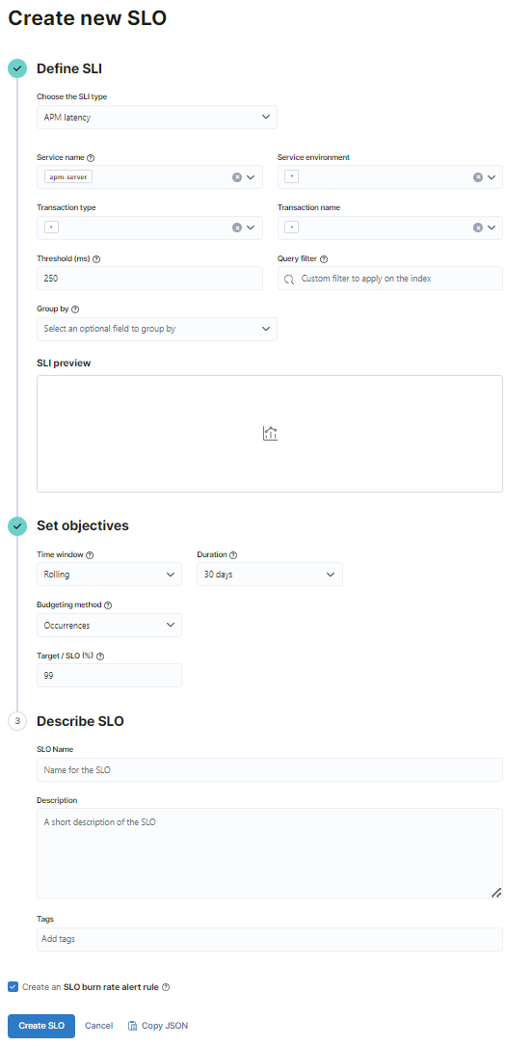
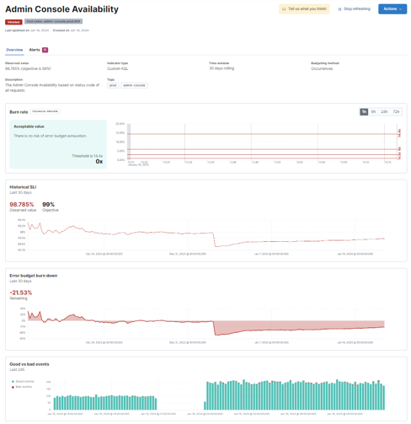
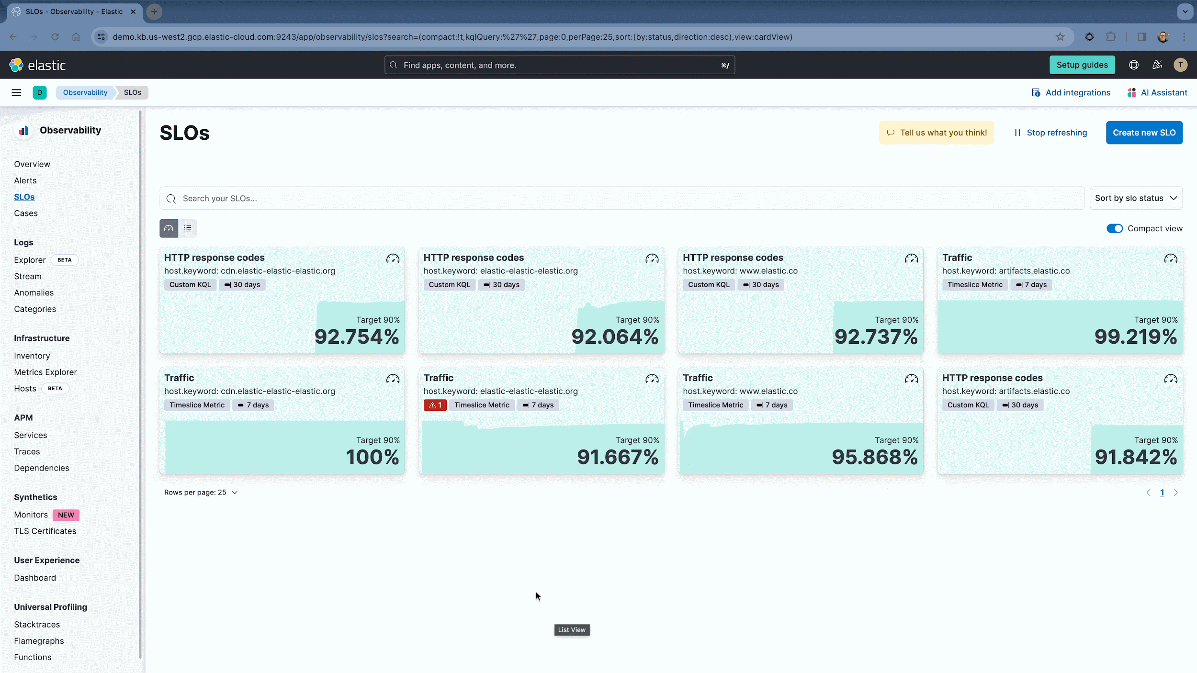
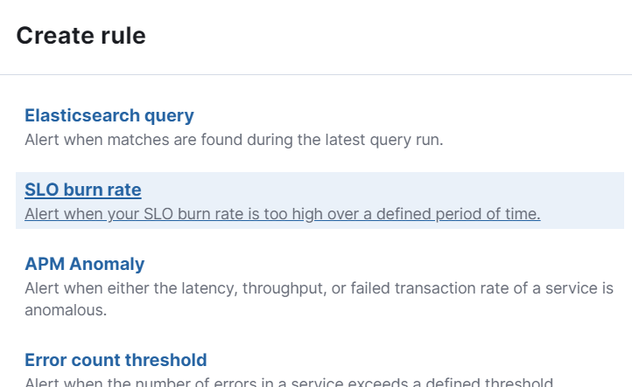
SLO Monitoring
Track objectives, manage error budgets
Define, manage SLOs
View SLO trends, error budget consumptions
Alert on SLOs, error rates
Notes:
For most SREs, SLOs is what they live by for symptom management. Understanding the level of performance and degradation of services helps track the health of your deployments and respond so much better.
And we are delighted to come up with a full fledged SLO feature that allows you to define, manage, and monitor SLOs. With intelligent defaults and out of box latency and availability SLO definition capabilities but also customizability with defining your own custom KQL based SLOs, this is a comprehensive featureset, with alerting capabilities around burn rates.

Slide 15








Consistent low latency search across all tiers
Balance visibility, retention, performance, and budget
Consolidate data
Balance for your budget
Automated data lifecycle management (ILM)
100% live, searchable data in all tiers
Lightning fast piped queries with ES|QL
Security
Observability
Business
Hot
$$$/GB
“NOW!”
Warm
$$/GB
“In a second”
Cold
$/GB
“In a minute”
Frozen
.$/GB
“In a couple mins”
Notes:
In addition to all the focus on innovation & making analysts as effective as possible - we talked a little bit about tool consolidation.
Elastic Security help you consolidate operational expenses under one platform - but also helps you dramatically reduce spend with automated data lifecycle management.
All of our data tiers are fully live and Searchable, even the lower tiers areas are highly performant levels.
This party research has validated that Elasticsearch in general 40-80% faster vs. the competitive benchmark.
So your analysts can hunt for unknown threats, or historical indicators across all your data - without breaking the bank

Slide 16
The result…
Scale
Speed
Relevance
Find the user impact in milliseconds within structured and unstructured datasets
Scale massively and horizontally across hundreds of systems to ensure you have the data you need
Get the right answers to find out what your system doing, if it’s working and how to fix it

Slide 17



Thank You

